Slide 1
GWADER ELECTRONIC MARKET
Presentation by: Adil khan & Asma

Slide 2
Outlines
Introduction to Gwader Electronic Market Place Project
The problems which can be automated
The Structure of your database
The features of our website
The layout of our website
The target users of our website

Slide 3
Introduction to Gwader Electronic Market Place Project
The project “Gwadar Electronic Market” is an E-commerce store. Which is the best platforms for Gwadar or nearby areas from where they can get multiple category and qualitative laptop and Mobile with reasonable price.

Slide 4
Continue
At our Website Gwadar Electronic Market you can get laptops and mobiles we have different range laptops and mobiles in the laptop where the customer can also be facilitated with discount on the product and we provide good quality Laptops and Mobile with responsible price our products are new brands and original costumer can order any time of the day we assure our customers that you are at right place.
This E-commerce store is facilitator for the people of Gwadar to Search and purchase the best product rather than using manual system for purchasing.

Slide 5
The problems which can be automated
The people who are facing various difficulties using manual system for searching, finding, and purchasing the desired products.
However, we would like to replace this traditional way with ONLINE ELECTRONIC MARKET where you can find a trustworthy Products with reasonable prices any time without wasting your precious time. They also people don’t need to go shop to shop for the search of finding the most brand new laptops or mobiles in the market.
Therefore, this website is developed for the people of Gwader that will hopefully, facilitate for finding, searching and purchasing the appropriate product by providing a platform that is available with all the necessary information that users might need.

Slide 6
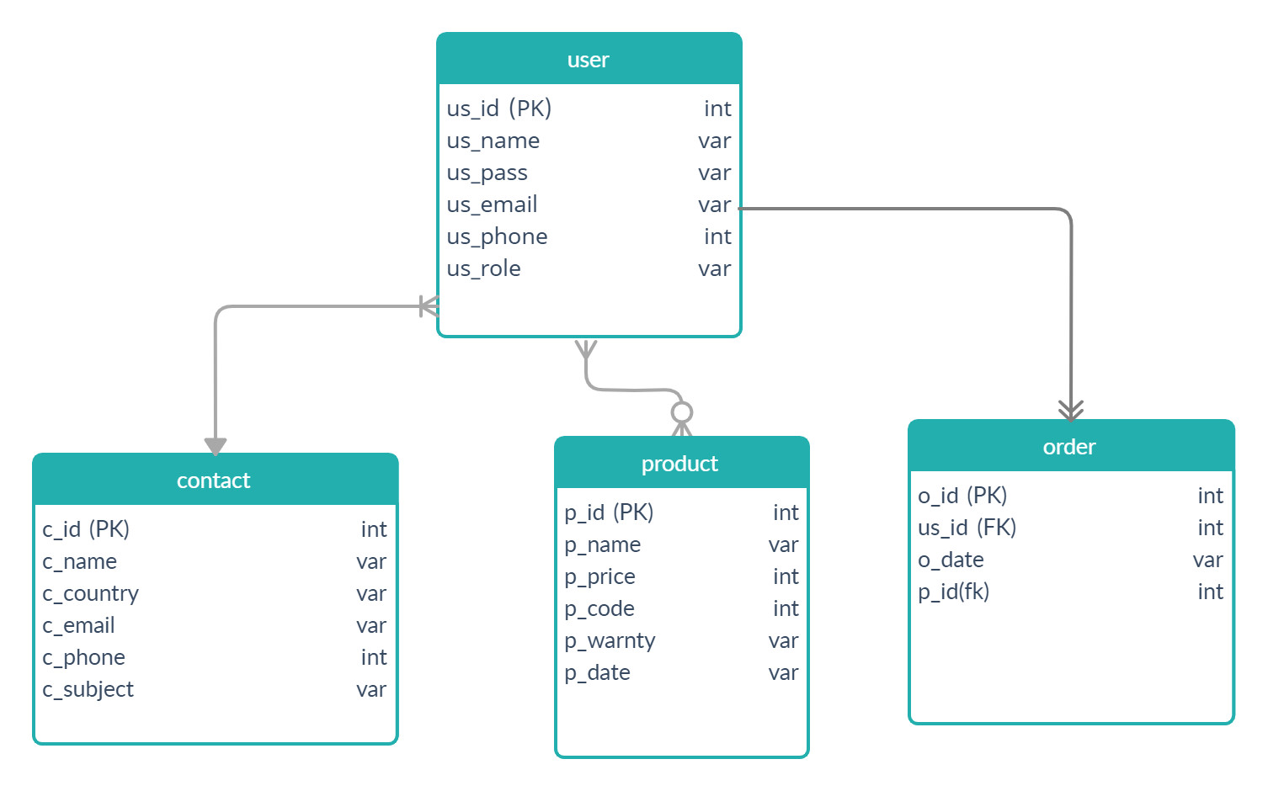
The Structure of your database
Following will be the structure of our website:
O_quantity int

Slide 7
Continue
In the structure of our website database, the entities which will be used are:
User [ Id,Name,Password, Phone No, Email,User Role]
contact [Id, Name, country ,Email, Phone No ,Subject]
order [id, User id, product id, order date,quntity]
product [product id, Name, price,product_code,product warnty,product date]

Slide 8
The features of our website
These are the important features of our online bookstore:
1. Two different type of Accounts
Admin/This is the main module in the proposed project. His role is supreme in this project. The admin can read and write information about any product. Admin also can add, delete and update the products and access user accounts and admin has authority to control overall activities of this website.
User / User is the valuable module of the system. The main target of the web site is user. User can get benefits by this website. This account will be used for user-based tasks like creating an user account /making a deal by purchasing a product, update invoice, print bills, return items add stock, adding a book to shopping cart, editing and viewing their transnational details etc.

Slide 9
2. Add account page:
System only provide admin, to update and add account info.
3. View/Add Customer:
These pages can be accessed by admin, System enable to give authority to admin to add and view Customer.
The transaction between customer and company can also be viewed in this page

Slide 10
4. Inventory:
These pages can be accessed by admin i.e., User Account which add or view a Stocks
Here, admin can also take advantages by viewing which product is selling more usual through a graph
6. Returns:
These pages can be accessed by admin i.e User Account which add or view returns
We return an item it automatically returned to inventory stock unless it is damaged

Slide 11
7. Payment:
Online payment refers to money that is exchanged electronically. Typically, this involves use of computer networks, the internet and digital stored value systems. Online payment usually is the transaction that results in transfer of money from the customer bank or credit card account to your bank account.
User can make the payment via the secured payment via Cash on Delivery Method
8. Stock:
Stock is used to manage the inventory add / remove stocks from inventory

Slide 12
9. Dashboard Panel:
Dashboard is a back end reporting interface that allows you to monitor your website performance by tracking metrics like visitors, pageviews, and online conversions.
10. Products Management:
As developers we pay attention on managing all the products, assigning category, pages, pricing and writing description for the products. Sorting them in their relevant section with due offers and tax/discount rates.

Slide 13
11. Electronic gadgets:
Portable electronic devices including smartphone, laptop, and notebook pcs will be sold in the website. Apart from it, its peripheral devices and other supporting gadgets are also available in the production section of the website.

Slide 14
The layout of our website
Login
Admin
User
Account Page (with delete permission) | View/add customer pages (with delete permission) | View/add customer pages
Manage overall site | View/add Inventory pages (with delete permission) | View/add Inventory pages
See the details of customers | View/add product pages (with delete permission) | View/add product pages
View transaction Details | View/add Returns pages (with delete permission) | View/add Returns pages
Modify ,alter any feature | View/add payment pages (with delete permission) | View/add payment pages
Manage inventor , stock | View/add statement pages (with delete permission) | View/add payment pages
Maintain and manage payment process | View/add stock pages (with delete permission) | View/add stock pages

Slide 15
The target users of our website
The laptop market targets a variety of groups,
Students
Technical Expert
Business men
Professionals
Employ of an organization
Game developer
Target user for mobile phones:
Every individual who uses smart phone
In short ,every phone or laptop user will be our target user

Slide 16
Think you

